Slide 1
Foglight Dashboard & Report Customization
Kyle Wang
Notes:
Welcome to the <Product or Solution> Web-based Training Course.

Slide 2
QUEST CONFIDENTIAL AND PROPRIETARY
This document (the “Document”) contains confidential information, trade secrets, and intellectual property of Quest. You may not reverse engineer, copy, modify, publish, disclose or disseminate any part of the Document without written permission from Quest. You have the privilege to use the Document solely for your internal use and solely as necessary for you to benefit under the applicable agreement you have executed with Quest.
© 2017 Quest Software Inc. ALL RIGHTS RESERVED.
This copyright notice does not imply publication of the Document or its contents.
Quest™, Foglight™, and the Quest logo are trademarks of Quest Software Inc. All other trademarks are property of their respective owners.
Notes:
Please review the Quest Confidential and Proprietary document and click Next.

Slide 3

Course Objectives
During this course we will cover:
Build a CIO Dashboard step by step.
Build a CIO Report step by step.
Notes:
During this course we will cover the following objectives:
Objective
Objective
Objective
Now that you have a better understanding of the course objectives, let’s begin the course.
Please click Next to advance the course.

Slide 4
What is WCF
WCF stands for Web Console Framework
Can be very easy (Drag and Drop)
Can be very powerful and flexible
Many Components to choose
Kinds of Renderers for rendering
Support Java/Groovy to do anything
Easy to bind Monitoring Data Model
…

Slide 5
Preparation

Slide 6
Preparation
Get Resources
Get Resources from a Flash Disk or
Download from Github: https://github.com/Foglight/DevCamp2017/tree/master/CIO_Dashboard

Slide 7
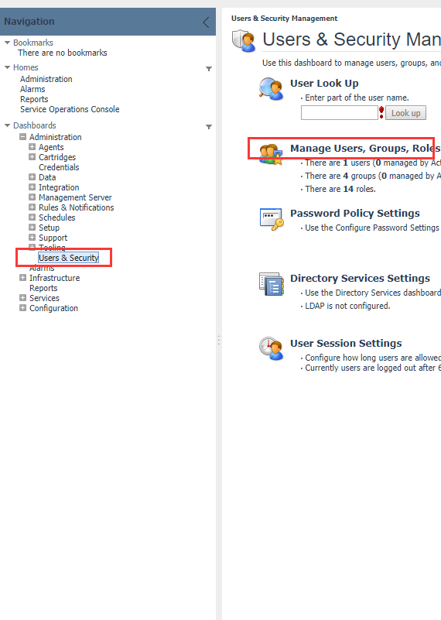
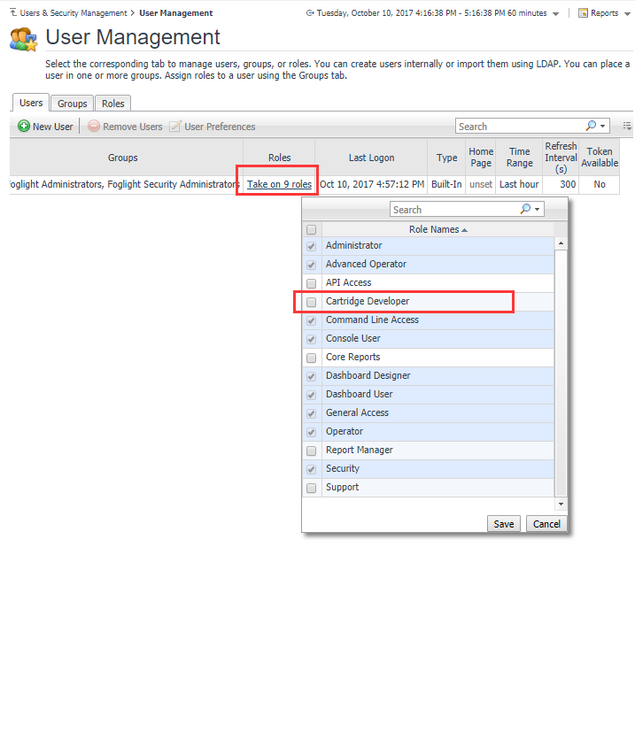
Preparation
Assign Developer Role

Slide 8
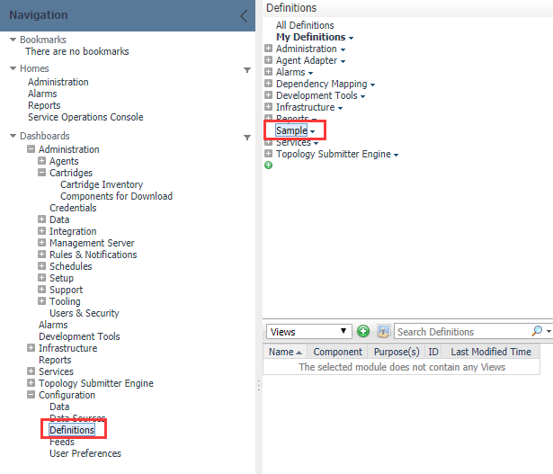
Preparation
Install cartridge “Topology-Helper-Tools-5_6_2.car”
Install “CIO-Dashboard-Get-Started-1_0_0.car”.

Slide 9
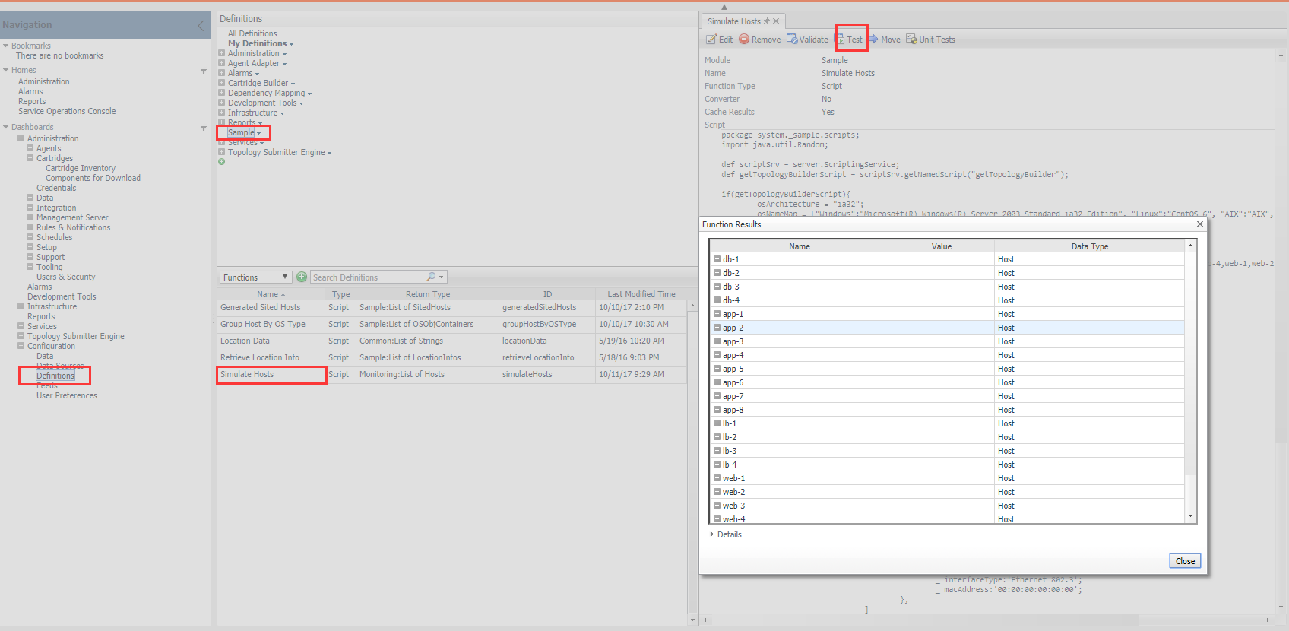
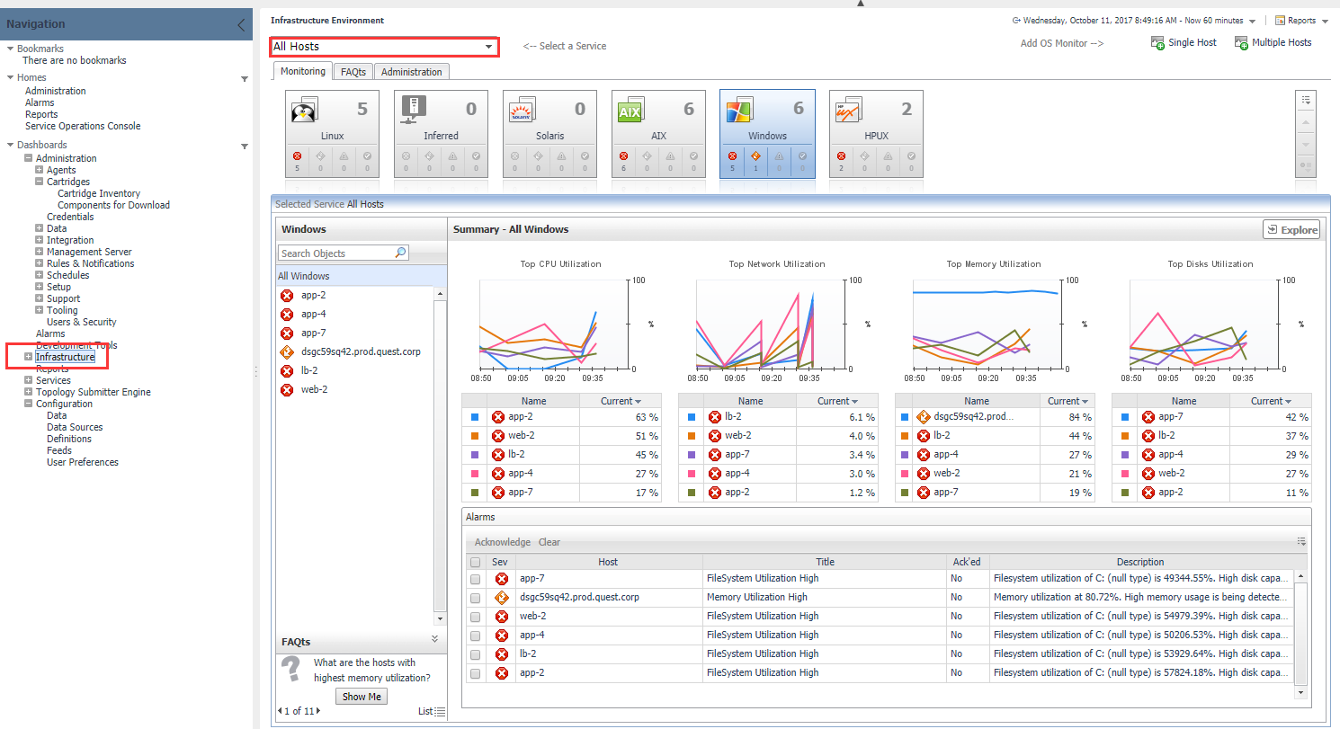
Preparation
Simulate Data and Verify
Run function: Sample → Function →Simulate Hosts →Test

Slide 10
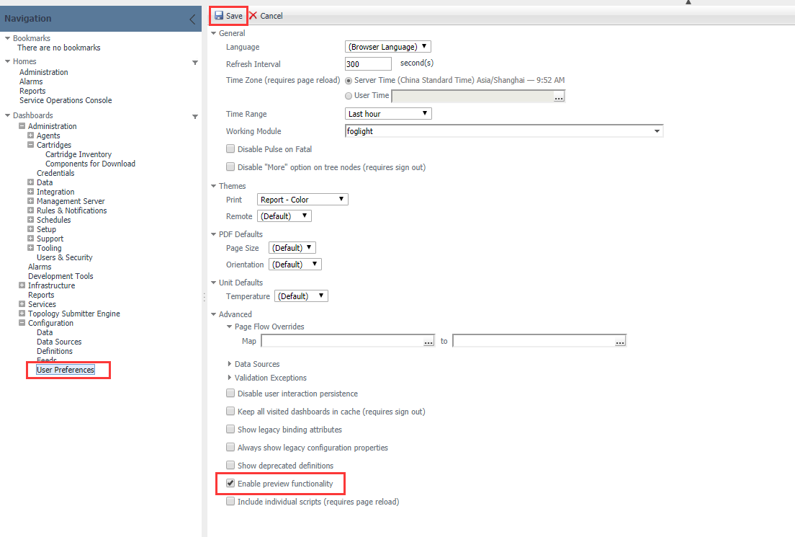
Preparation
Enable preview functionality to use Map

Slide 11
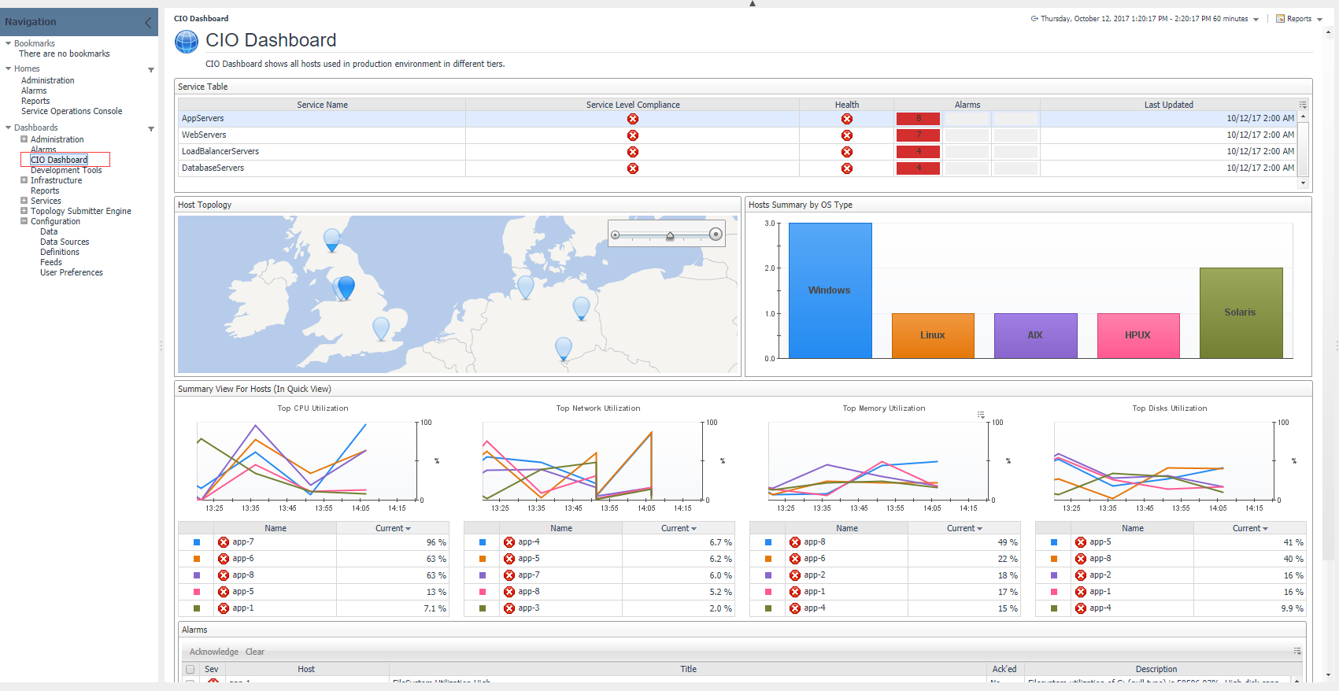
Use Case
You have many hosts that have different applications running on.
The applications belong to different tiers, Web, Database, App, etc.
You want to know the health for each tier.
Each tire is a service contains the hosts.

Slide 12
Build Services
Notes:
Scenario:
Assume we have many hosts in the world, we need to know the SLA of specific region; To make things clear, we will group hosts by region, each region is a service;

Slide 13

Lesson Objectives
During this lesson we will cover:
Services Builder dashboard usage
Add root data for CIO dashboard

Slide 14
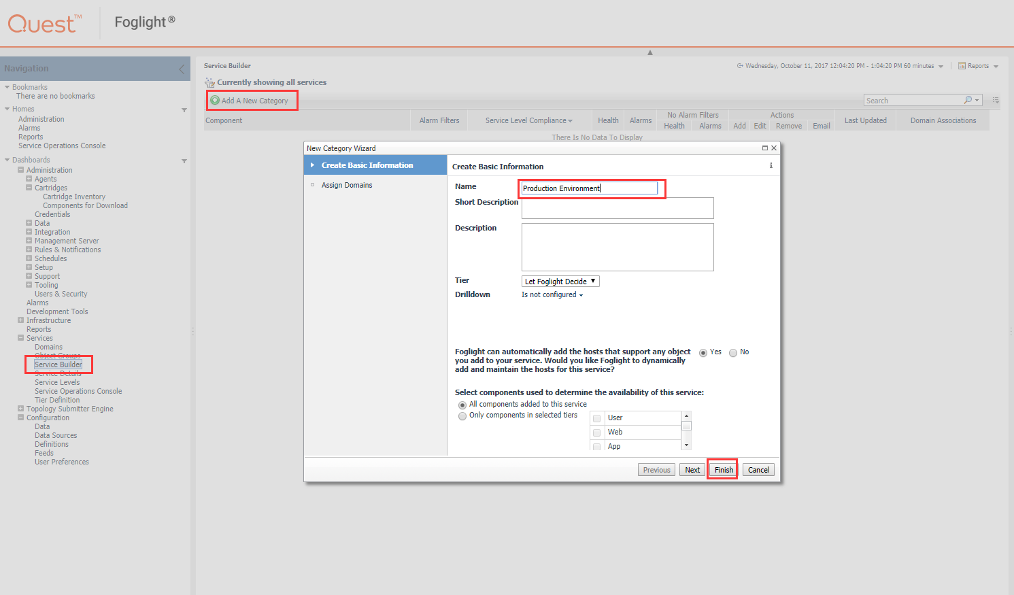
Build Services
Add a Category
Add a Service Category named “Production Environment”

Slide 15
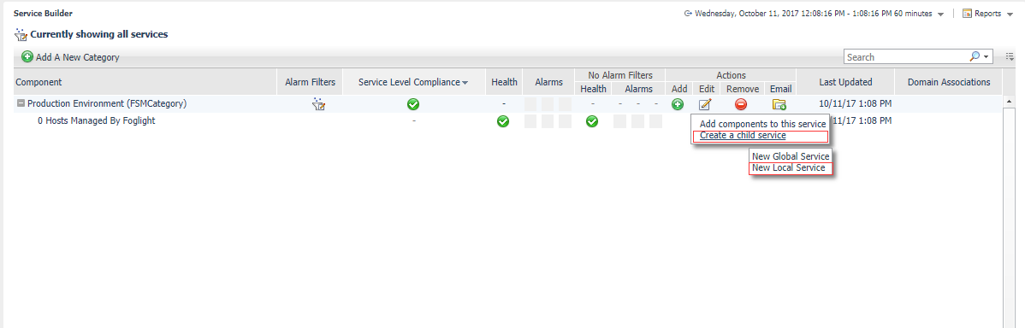
Build Services
Add Child Services
WebServers
LoadBalancerServers
AppServers
DatabaseServers

Slide 16
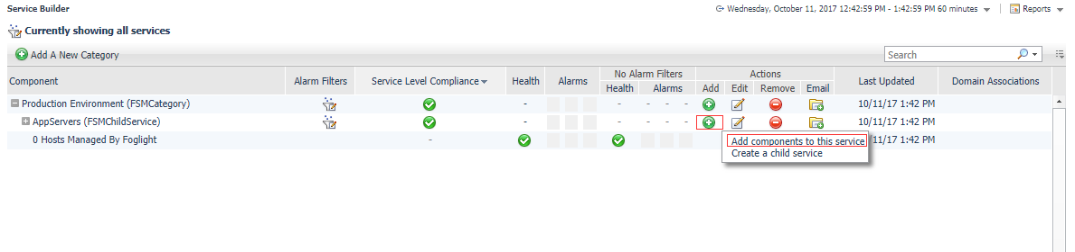
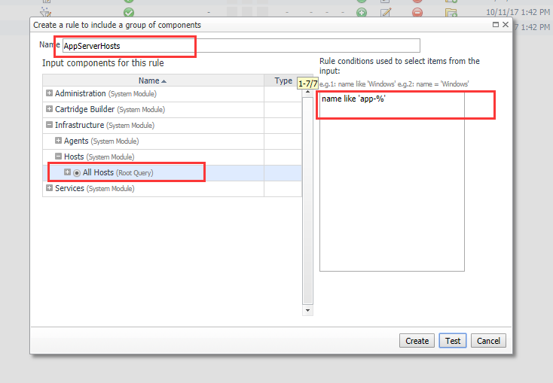
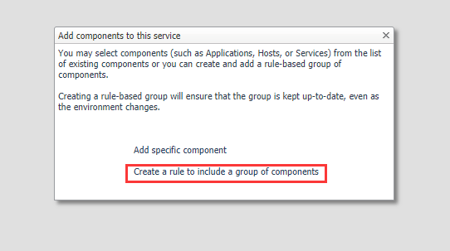
Build Services
Add Child Service Components
WebServers
name like ‘web-%'
LoadBalancerServers
name like 'lb-%'
AppServers
name like 'app-%'
DatabaseServers
name like ‘db-%'

Slide 17
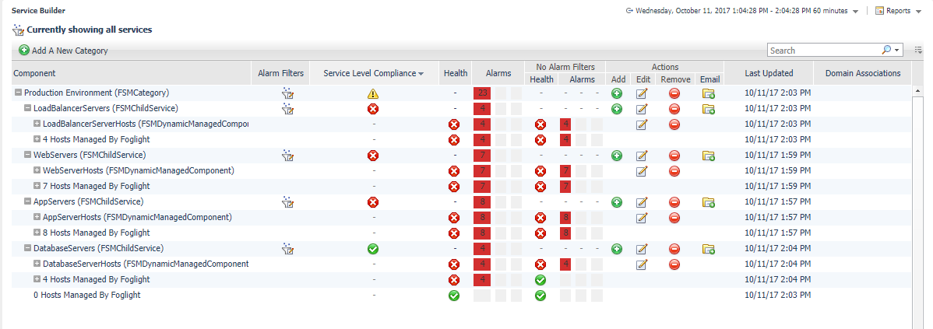
Build Service
The Whole Category Overview

Slide 18
Make the Dashboard

Slide 19
Lesson Objectives
During this lesson we will cover:
How to add a Query
How to add a View
How to use Layout

Slide 20
Make Service Table

Slide 21
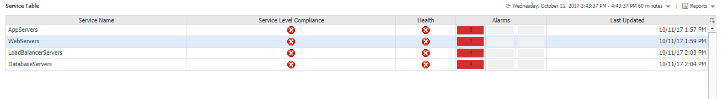
Goal for Service Table

Slide 22
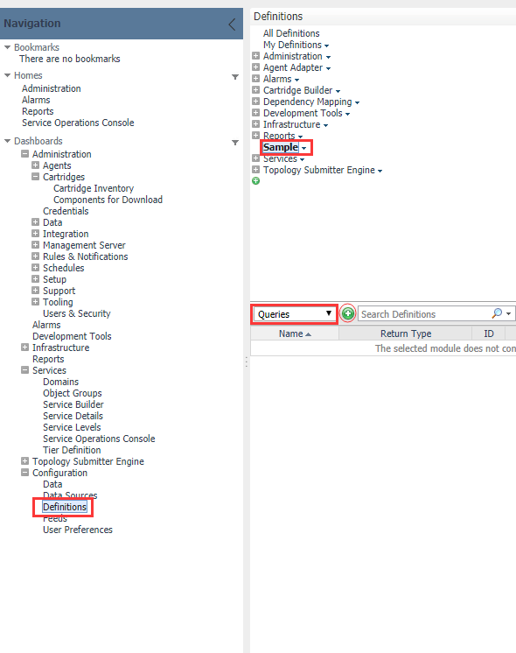
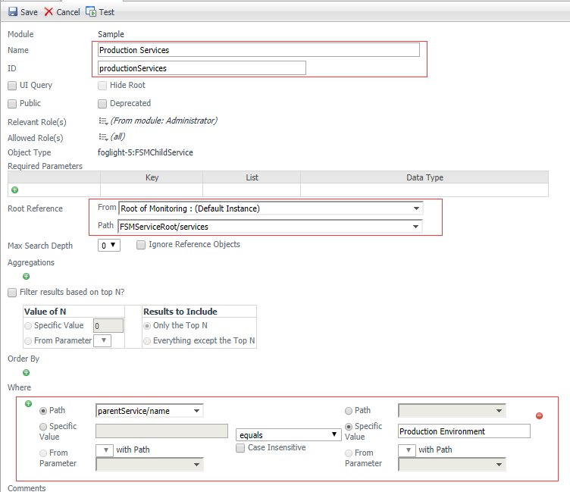
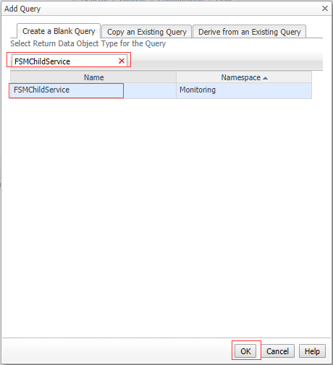
Add a Query

Slide 23
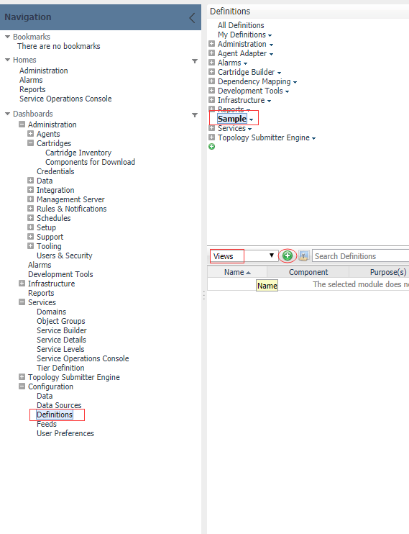
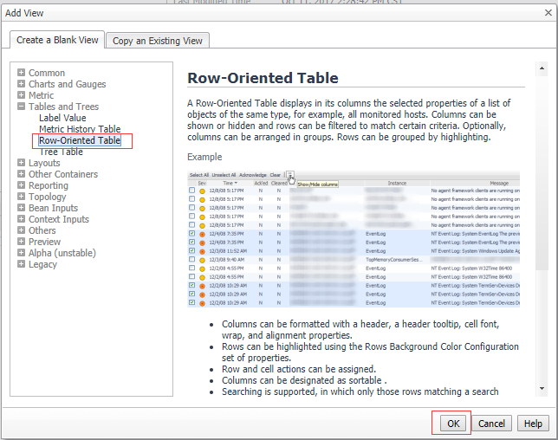
Add a Row-Oriented Table

Slide 24
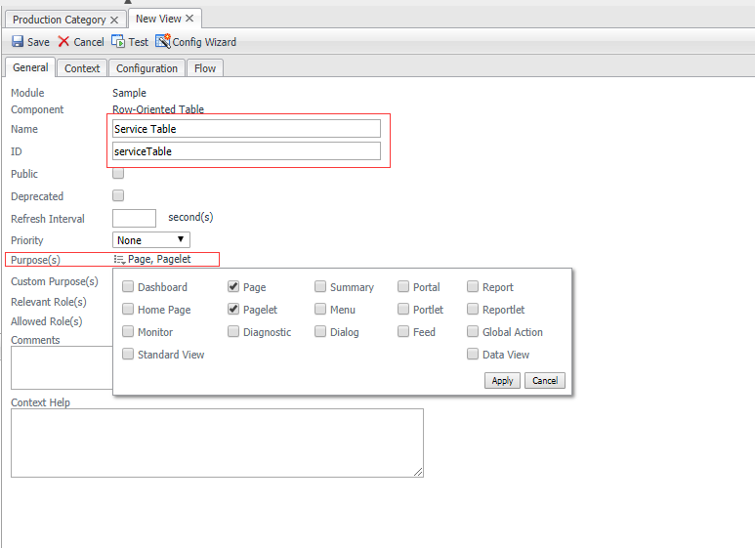
General Setup for Table

Slide 25
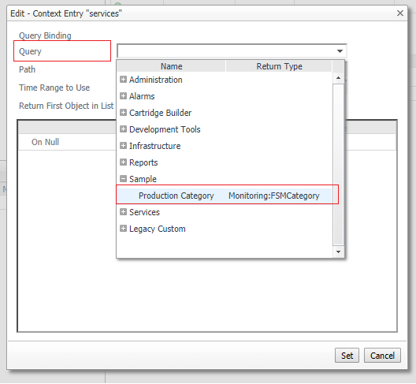
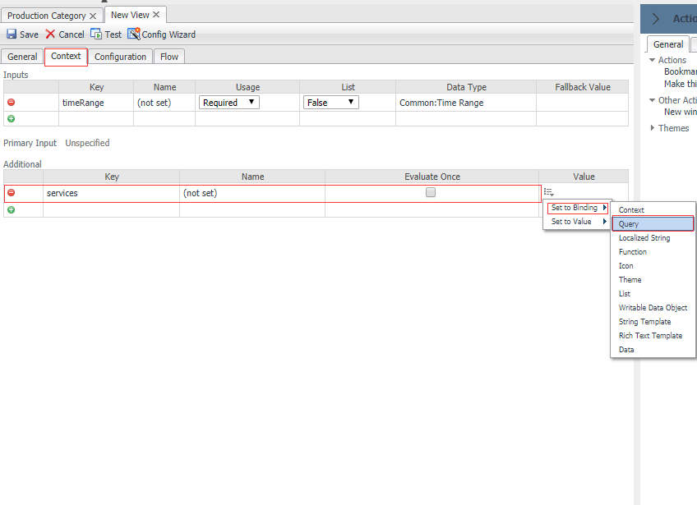
Context Setup for Table

Slide 26
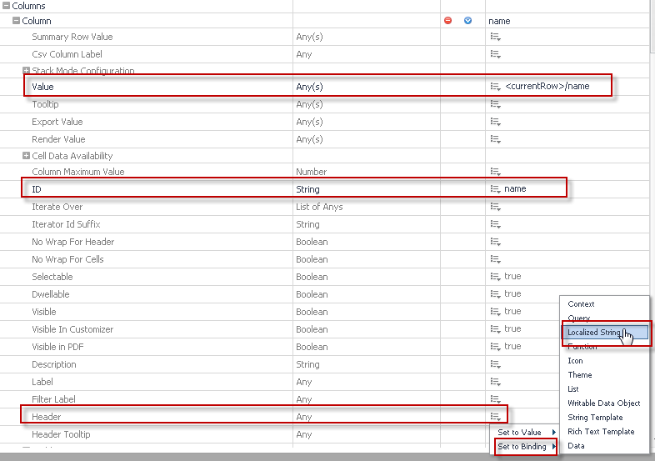
Configurations for Table
Configure Rows
Configure Columns
ID
Value
Header
Localized String is recommended

Slide 27
Table Column Configurations
Name
Value: name
Id: name
Header: Service Name
Service Level Compliance
Value: aggregateStateSeverity
Id: SLAState
Header: Service Level Compliance
FatalCount
Value: alarmAggregateFatalCount
Id: fatalCount
CriticalCount
Value: alarmAggregateCriticalCount
Id: criticalCount
WarningCount
Value: alarmAggregateWarningCount
Id: warningCount
Health
Value: aggregateState
Id: health
Header: Health
Last Updated
Value: lastUpdated
Id: lastUpdated
Header: Last Updated

Slide 28
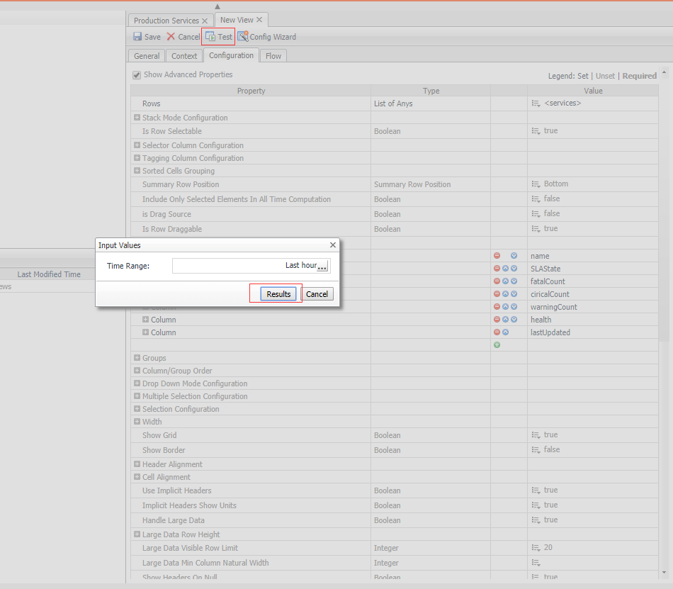
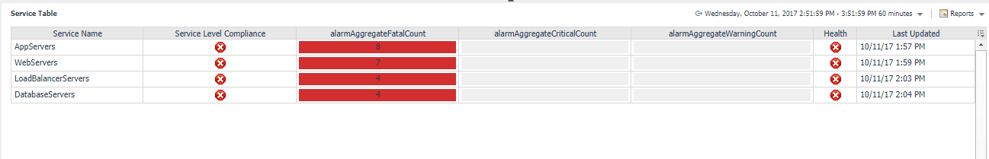
Test Service Table

Slide 29
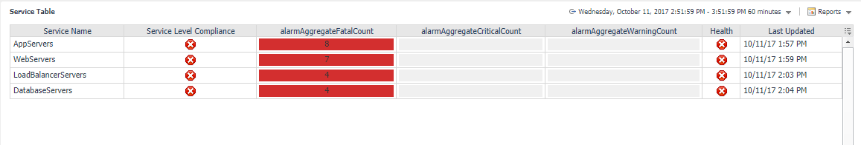
Improve Service Table
Add alignment for some column
Group fataCount, criticalCount and warningCount as “Alarm”
Change column order
Add single row action(name: selectedService)
Notes:
Alignment:
SLAState, cell alignment “Center”
fatalCount, cell alignment “Center”
criticalCount, cell alignment “Center”
warningCount, cell alignment “Center”
health, cell alignment “Center”
lastUpdated, cell alignment “Right”
Group:
fatalCount
criticalCount
warningCount
Use Implicit Headers: false
Group Order:
– Name, SLAState, health, alarm, lastUpdated
Note:
Describe the purpose of single row action and context

Slide 30
Make Hosts Map

Slide 31
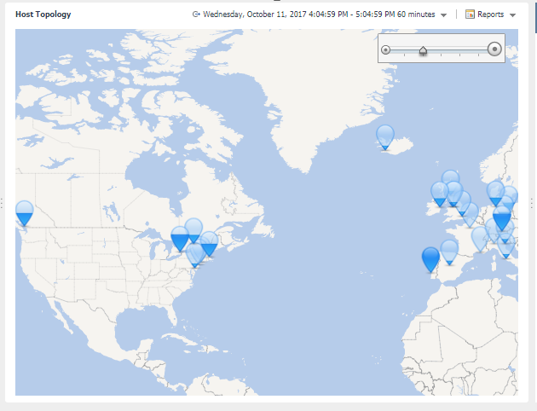
Goal for Hosts Map

Slide 32
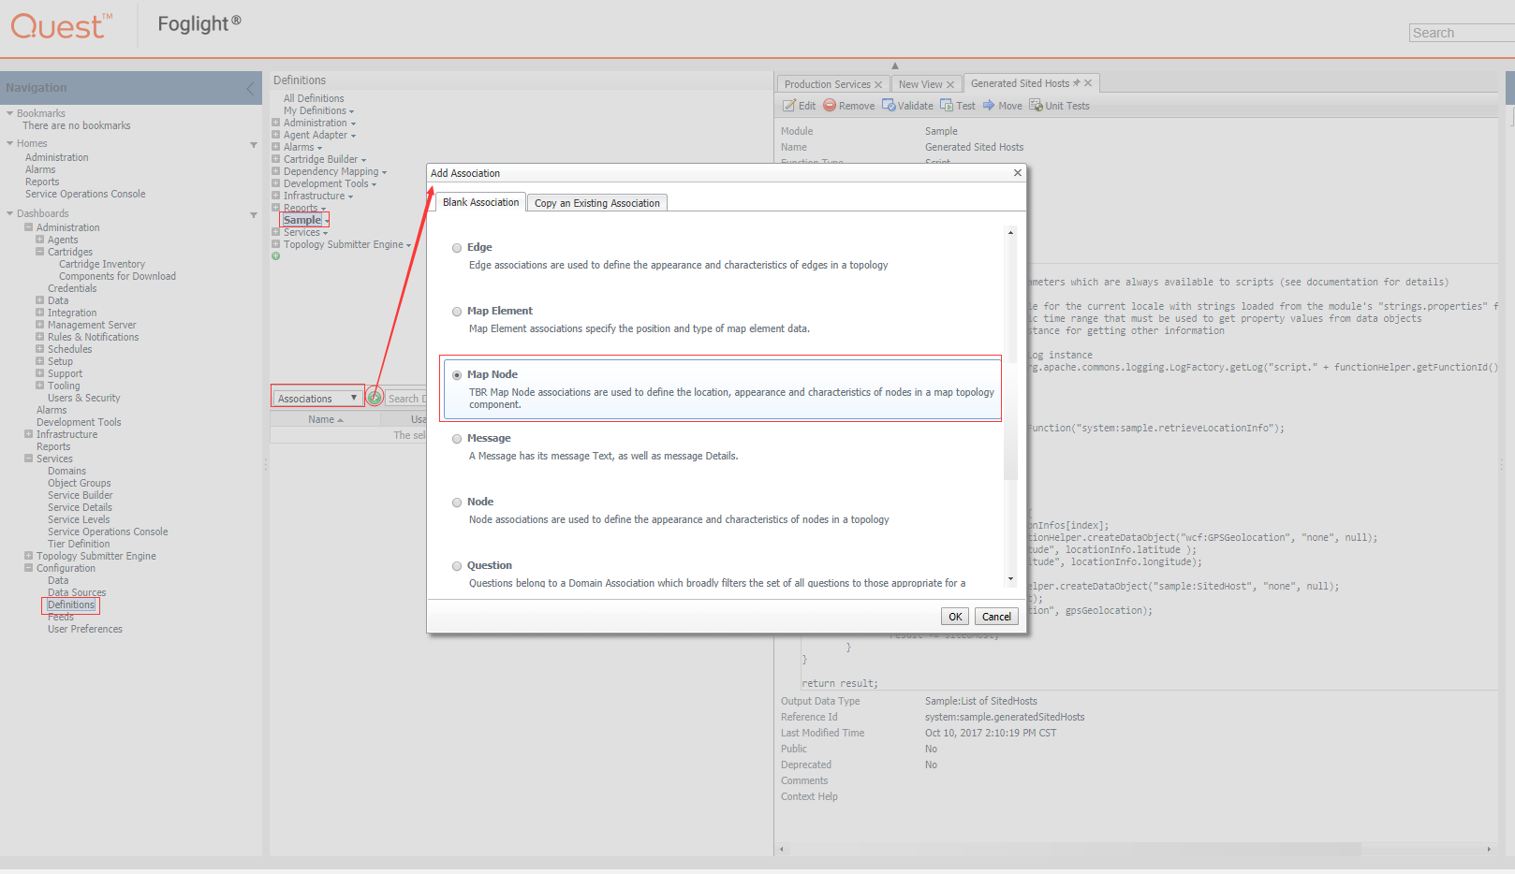
Add a Map Node Association
Map Node Association
Used to provide latitude, longitude and value for each node associated with Map Topology Component.

Slide 33
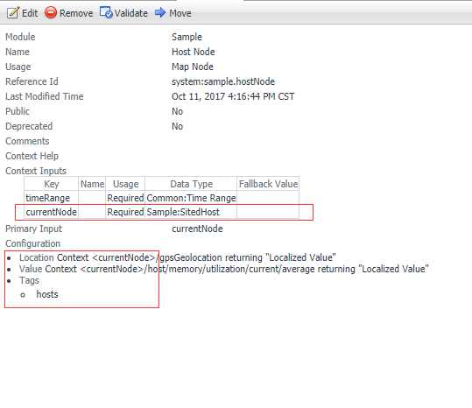
Configure Map Node Association
Add a context with name “currentNode”, this is a convention.
Tag is used to build the relationship with Map Topology.

Slide 34
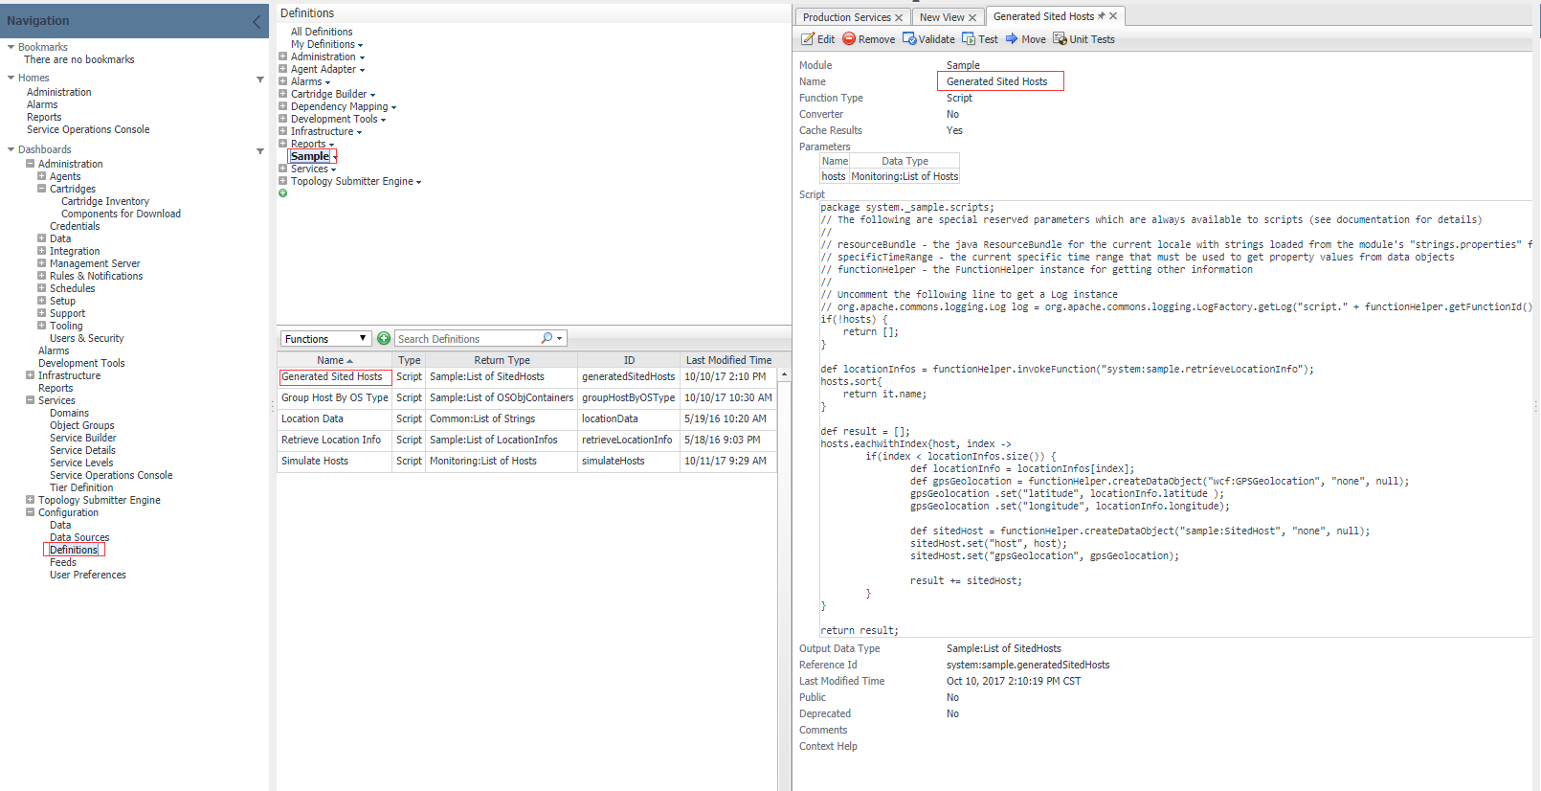
Add Types and Functions to Wrap Host with Geo Location
We prepared the functions and types already.
You could find them in sample module.

Slide 35
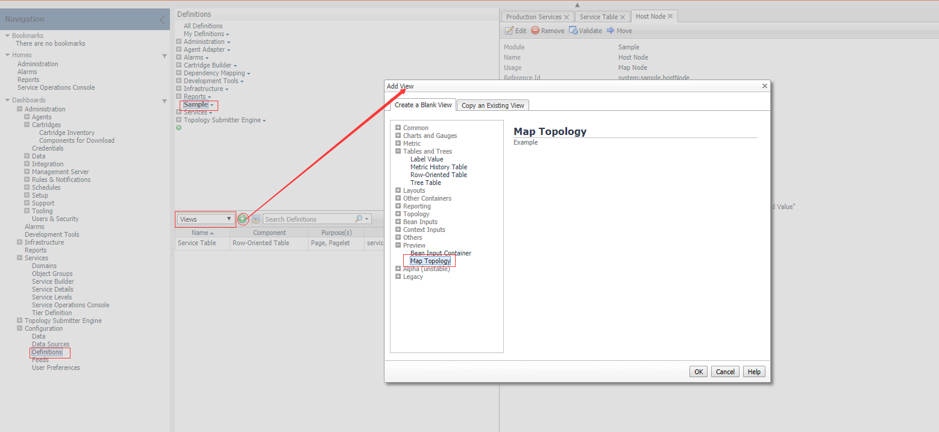
Add a Map Topology

Slide 36
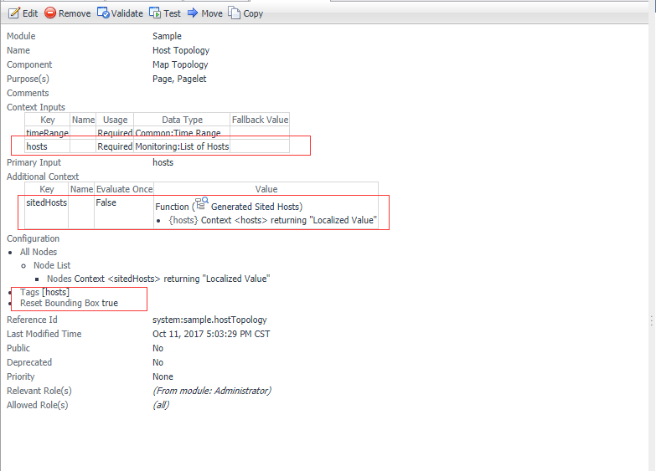
Configure the Map Topology
Add context “hosts” as Input
Invoke function “Generate Sited Hosts” to convert hosts to sitedHosts.
Specify the tag which is the same with Map Node Association.
Test after Save.

Slide 37
Make Hosts by OS Type Bar Chart

Slide 38
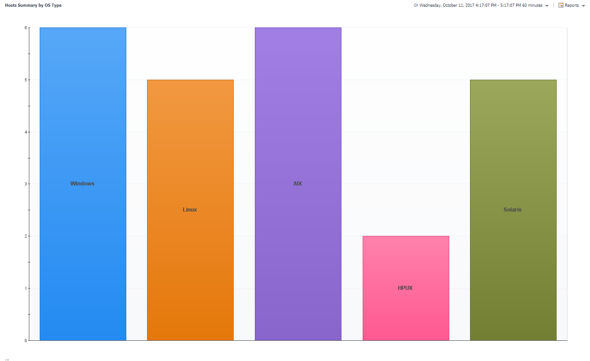
Goal for Hosts by OS Type Bar Chart

Slide 39
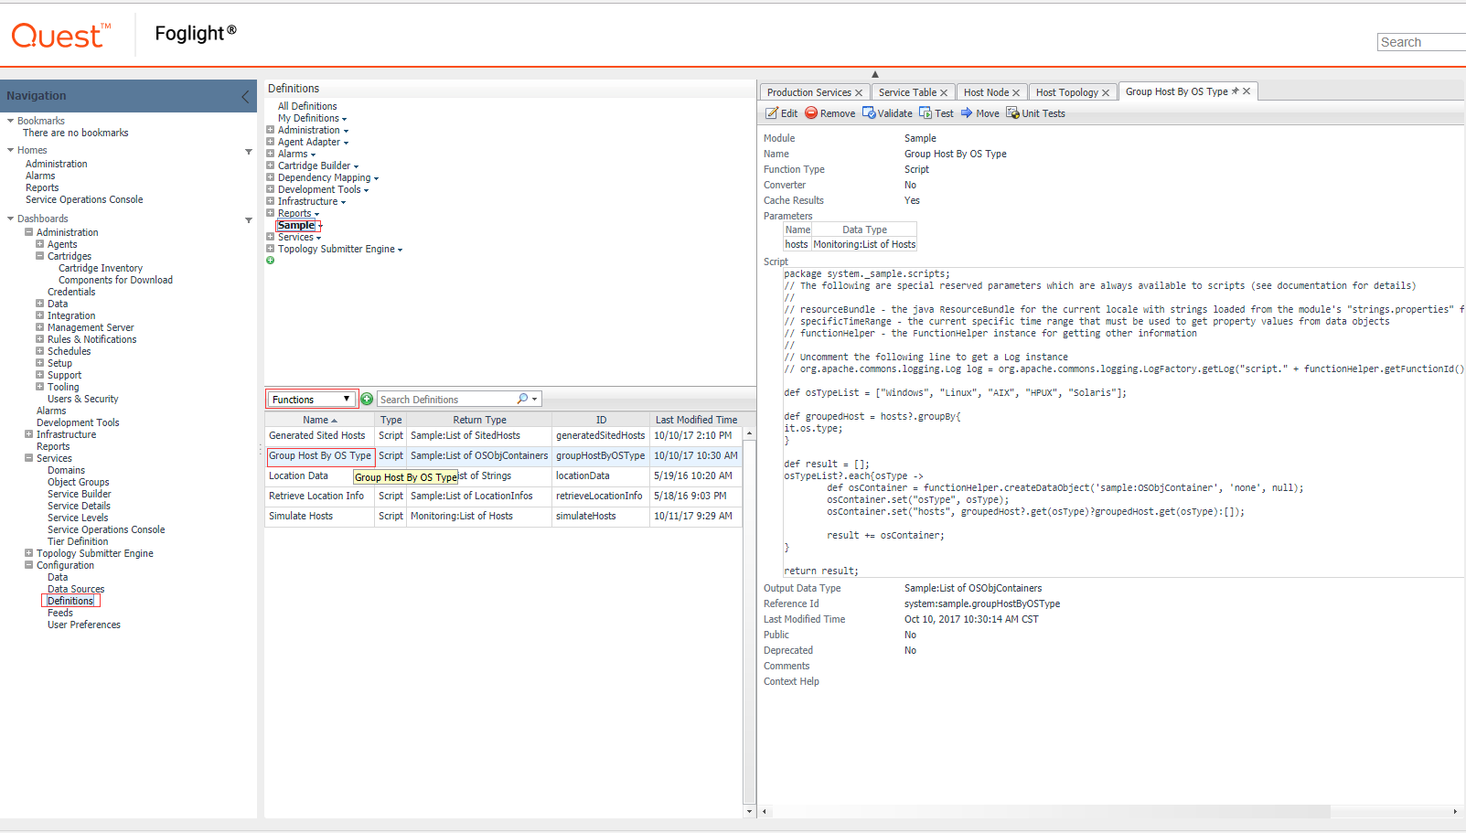
Add Type and Functions to Wrap Hosts by OS Types
We prepared the functions and types already, could be used directly.

Slide 40
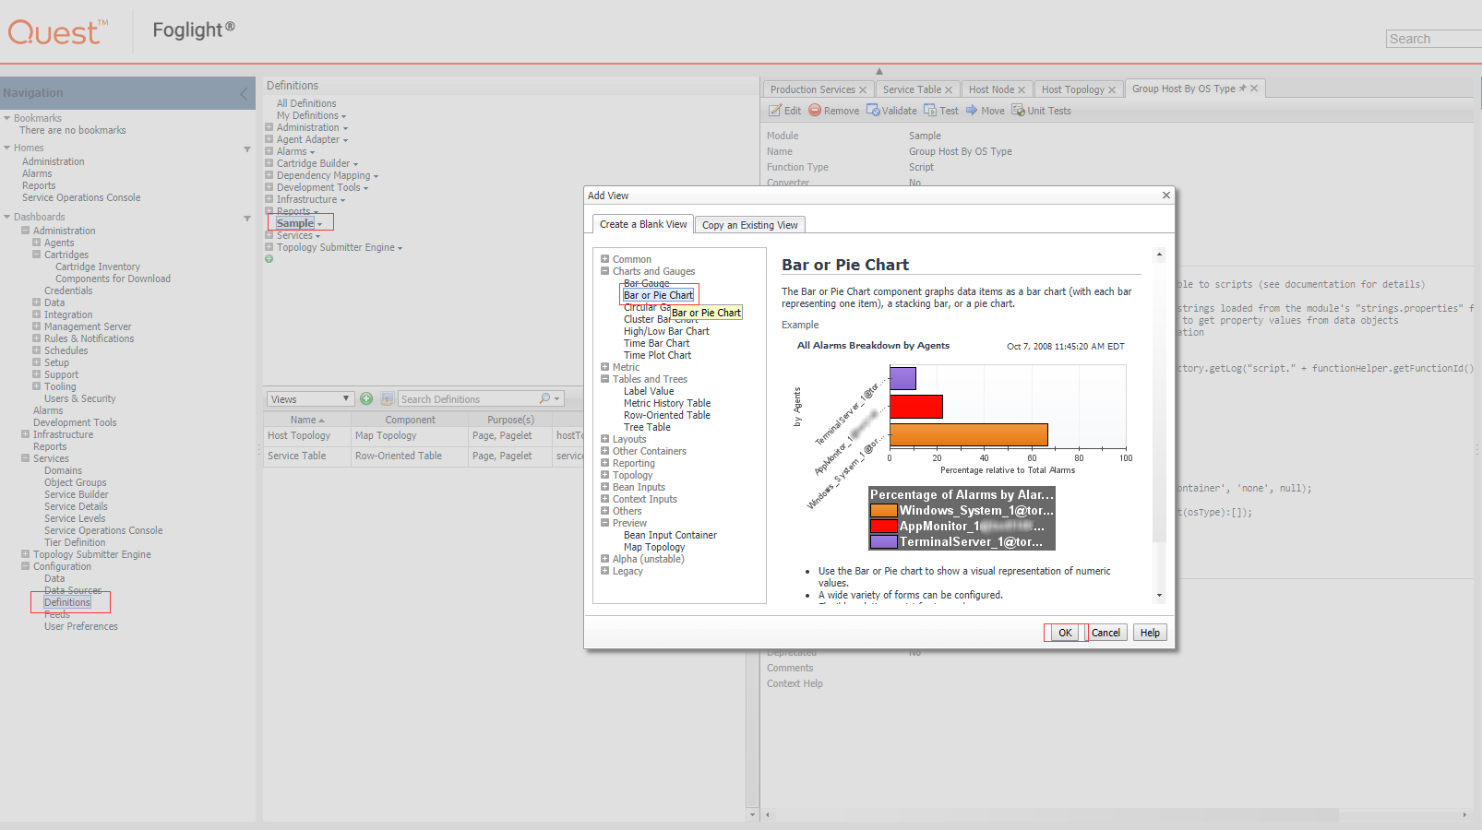
Add a Bar or Pie Chart

Slide 41
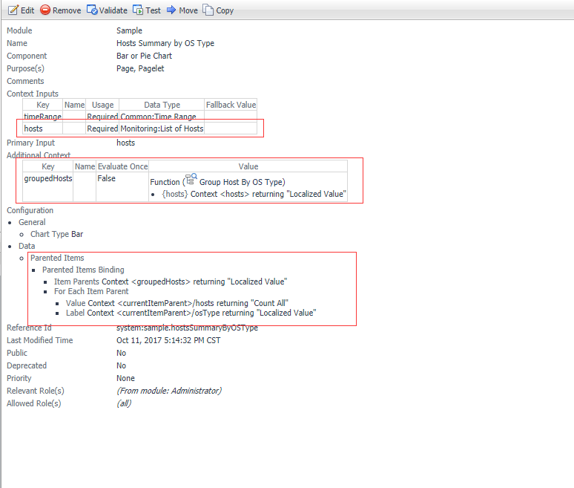
Configure the Bar or Pie Chart
Add context hosts as Input
Invoke function “Group Host by OS Type” to group the hosts by OS.
Configure “Parent Items”

Slide 42
Copy Resources Summary View

Slide 43
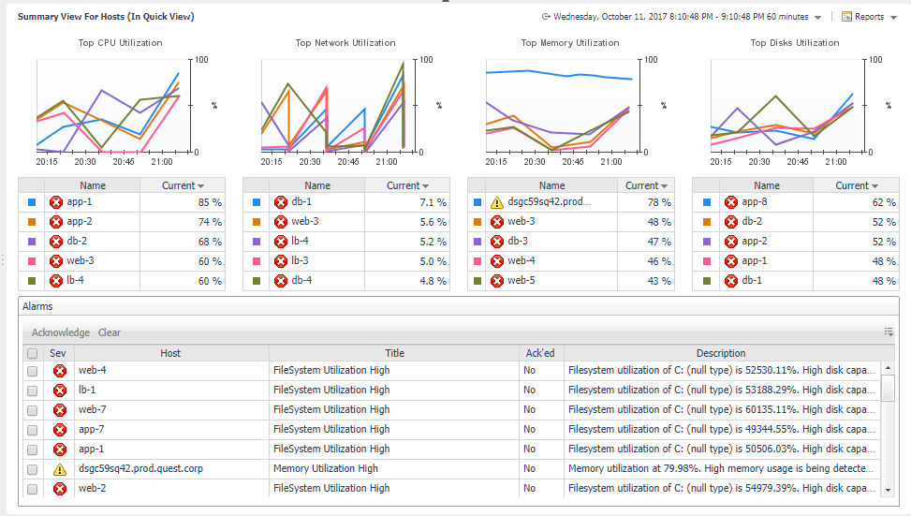
Goal for Resource Summary

Slide 44
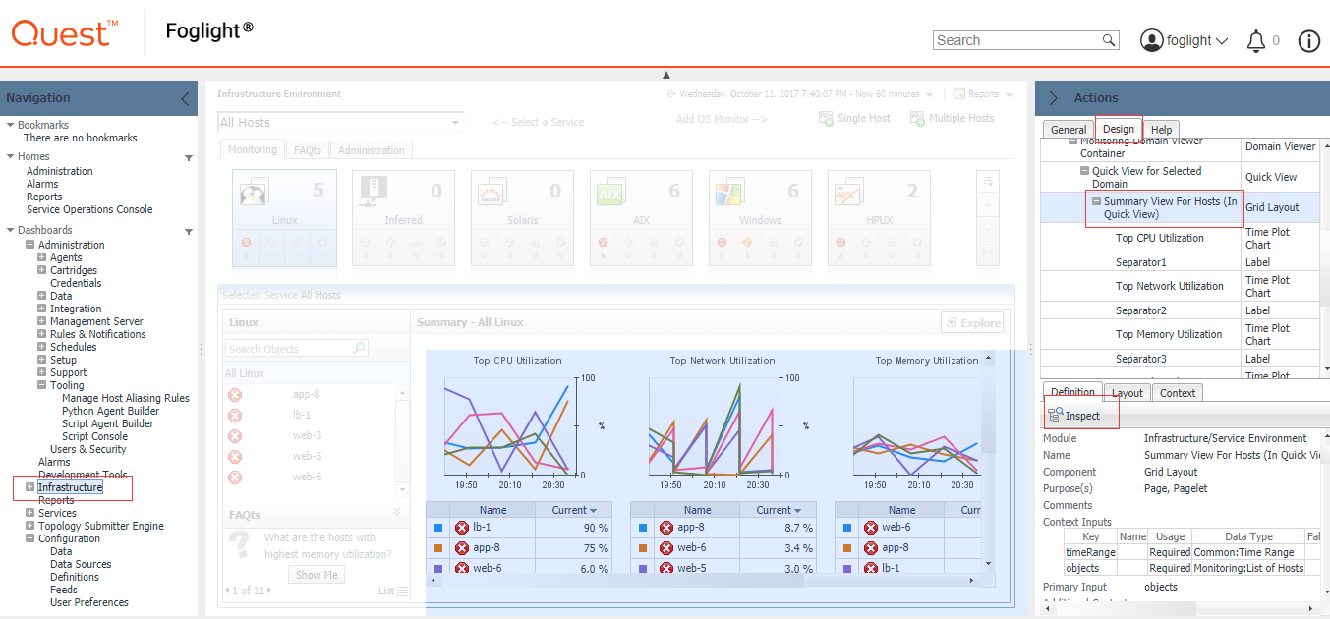
Locate Resource Summary View within IC
Use WCF Investigation (Design Tab) to locate the View.
Inspect into the View to edit.

Slide 45
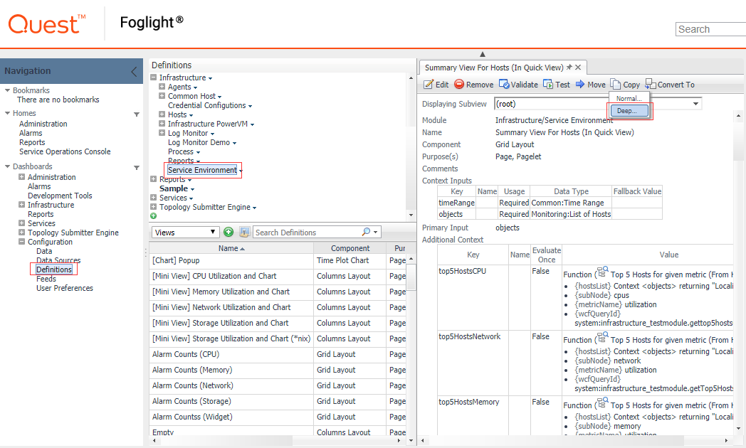
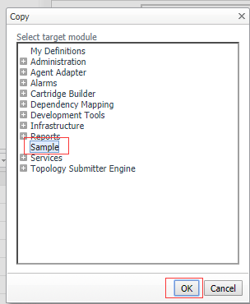
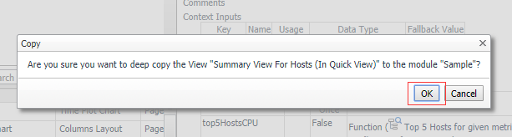
Copy Resource Summary from IC

Slide 46
Construct CIO Dashboard

Slide 47
Goal for CIO Dashboard

Slide 48
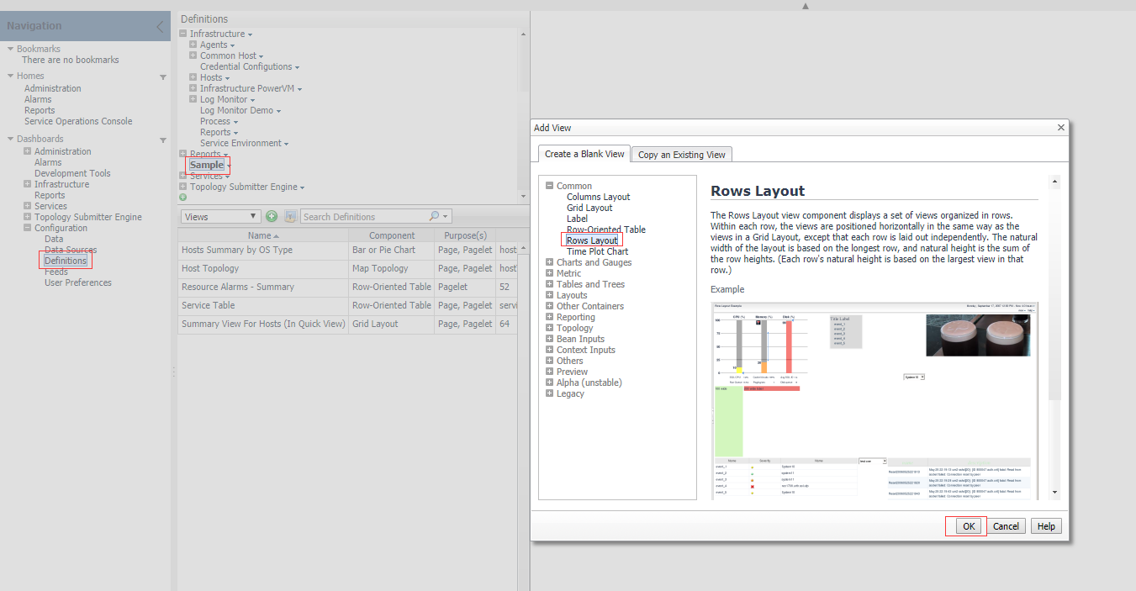
Add a Rows Layout

Slide 49
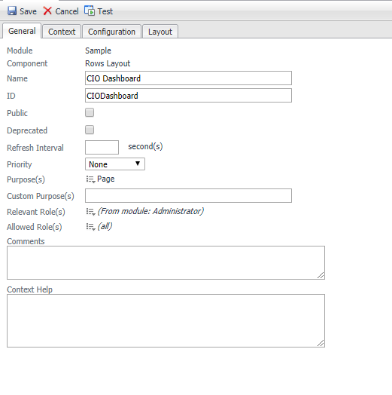
General Setup for Layout
Name: CIO Dashboard
Purpose: Page

Slide 50
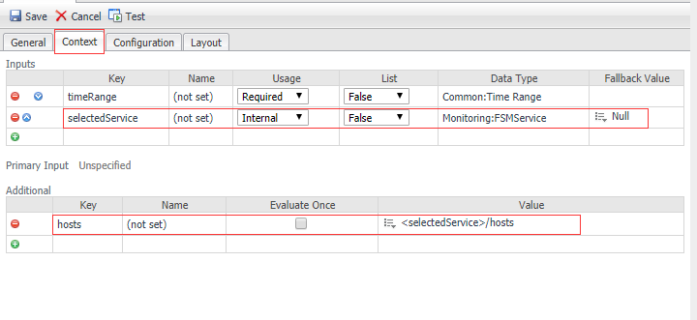
Context Setup for Layout
selectedService: this context is used to pass the value of selected service in Service Table.
hosts: values are from the selectedService, and it is required by views ‘Host Topology’ and ‘Hosts Summary by OS Type’.

Slide 51
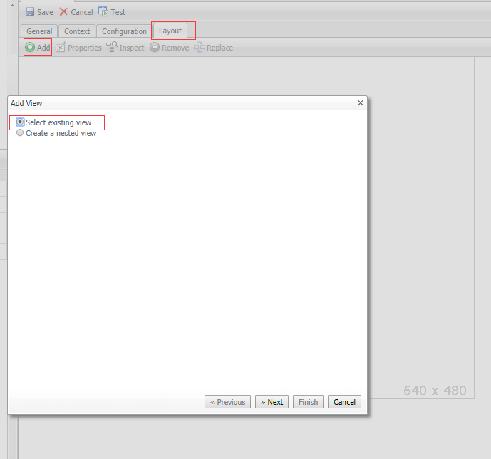
Add Service Table to Layout – Step 1

Slide 52
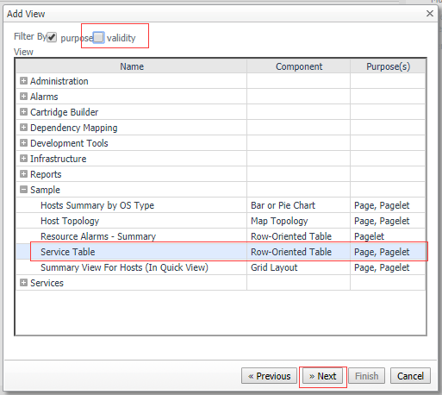
Add Service Table to Layout – Step 2

Slide 53
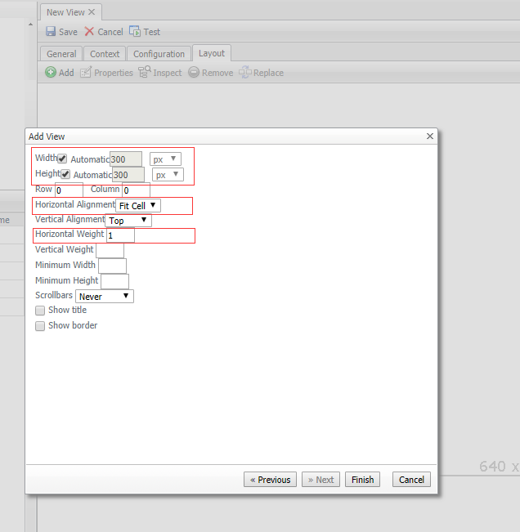
Add Service Table to Layout – Step 3

Slide 54
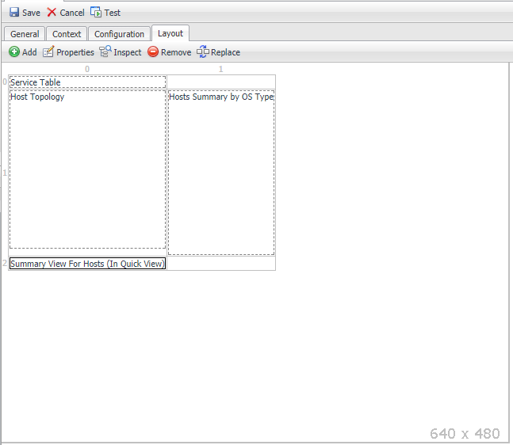
Add Service Table to Layout – Step 4
Add other views to Layout in the same way
Host Topology
Host Summary by OS Type
Summary View For Hosts (In Quick View)
Note, the input of Summary View For Hosts (In Quick View) is objects, which is not match with any context of this Layout, should convert context hosts to objects when adding this view.

Slide 55
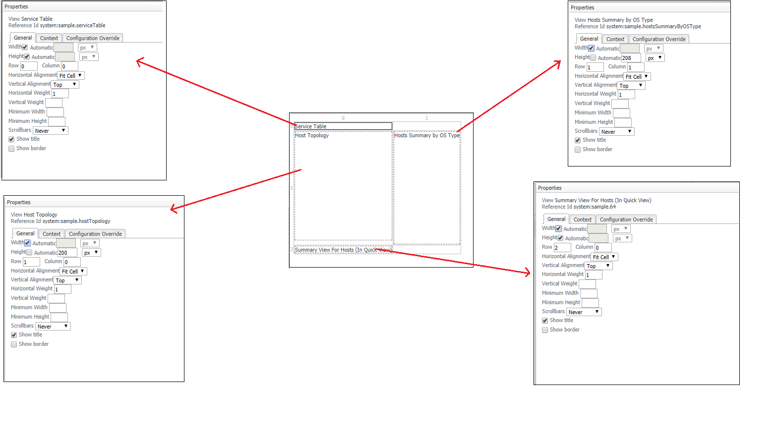
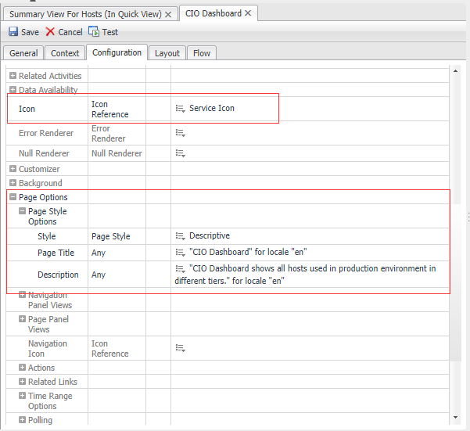

Adjustments for Contained Views
Specify following properties for each view in Layout
Width
Height
Row
Column
Alignments
Weight: means how much space it should occupy compared with other views.
Show Title
Add a Page Title
Give a Nature height for Sizing
Bind ‘CIO Dashboard’ to module as Main View so that a dashboard link appears in Navigation panel.
Finally, change module name to ‘CIO Dashboard’.

Slide 56
Make a Report Template

Slide 57

Add a PDF Layout
PDF Layout is a PDF template that contains the reportlets.

Slide 58

General Setup for PDF Layout
Purpose: Report

Slide 59

Context Setup for PDF Layout
Add context selectService and additional context hosts as Rows Layout does.
In addition, add context pageNumber for PDF footer.

Slide 60

Add Reportlet to PDF Layout
Add following views to Layout
Service Table
Host Topology
Hosts Summary by OS Type
Summary View For Hosts(In Quick View)
Page Header
Page Footer
Page Header and Page Footer should be ahead of other views.
It’s recommended that all contained views have fixed width and height.
Don’t forget convert hosts to objects for Summary View For Hosts(In Quick View).
Page header and footer could use existing ones under module Administration/Management Server/Reporting

Slide 61

Test CIO Report

Slide 62


Associate CIO Report to CIO Dashboard
Edit the Configuration of CIO Report
Configure the Report Options

Slide 63
Next Steps
Add actions to following places
SLA Detail
Health Detail
Alarm Detail
Map improvement – Bubble select & Dwell

Slide 64

SLAState Select Action
Notes:
Edit Service Table -> Flow, Popup Services/Explorer/FSMService Service Level Compliance Summary

Slide 65

Service Health Select Action
Notes:
Edit Service Table -> Flow, Popup Administration/Management Server/Commons/TopologyObject aggregateState Summary

Slide 66

Alarm Count Select Action
Notes:
Edit Service Table -> Flow, Popup Alarms/Alarm List As Popup (TopologyObject)

Slide 67

Host Topology Bubble Actions
Notes:
Edit Association Host Node
Popup Infrastructure/Hosts/Host/Host Summary with Status when Dwell
Next to Page Infrastructure/Hosts/Host Monitor when Select

Slide 68

Notes:
Thank you for attending this web-based training course.
Now that you have completed this training course, please take a few moments to complete a brief survey on the next slide. Your feedback is invaluable in helping us develop better training courses and ensure future training content is delivered as effectively as possible.
Use the Previous and Next buttons inside the player stage to navigate the pages in this survey and click the Finish Survey button to submit your survey.
Please click Next to begin the survey.

